Slide 1




Annual Public Lecture 2026
Keeping Our Children and Young People Safe Online
Wednesday 25 February 2026

Slide 2
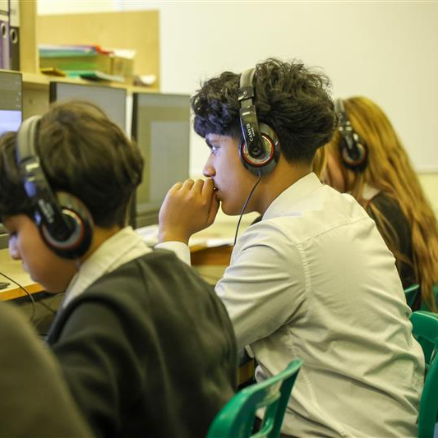


About the Violence Reduction Network (VRN)
Established in 2019, we are a broad alliance of individuals, groups and organisations determined to prevent and reduce violence in our area.
Our mission is to achieve ‘prevention through connection’ by building an inclusive, collaborative and courageous network which will drive the short and long-term change required to successfully tackle the causes and consequences of violence.
We take a public health approach, using data, insights and research to identify the root causes and co-design and test preventative solutions.
We prioritise children and young people and focus on preventing public place violence and other related- harms such as exploitation. This year we are also prioritising preventing online harms.
We believe everyone has a role in preventing violence and associated harm – keeping our children safe in the physical and online space requires a whole system approach.

Slide 3
Deepfakes
Online grooming/
exploitation
Cyber-bullying and mobbing
Fraud
Scams and phishing
Hacking
Hate
Trolling
Online harms affecting children and young people
Image based sexual abuse
Disinformation
Gambling
Exposure to eating disorders
Radicalisation
Cyber-stalking
Identity theft
Harmful challenges and trends
Violent and hateful content
Denigration
Exposure to self-harm
Doxxing
Catfishing
Gaming Harms
Financial exploitation
Harassment

Slide 4
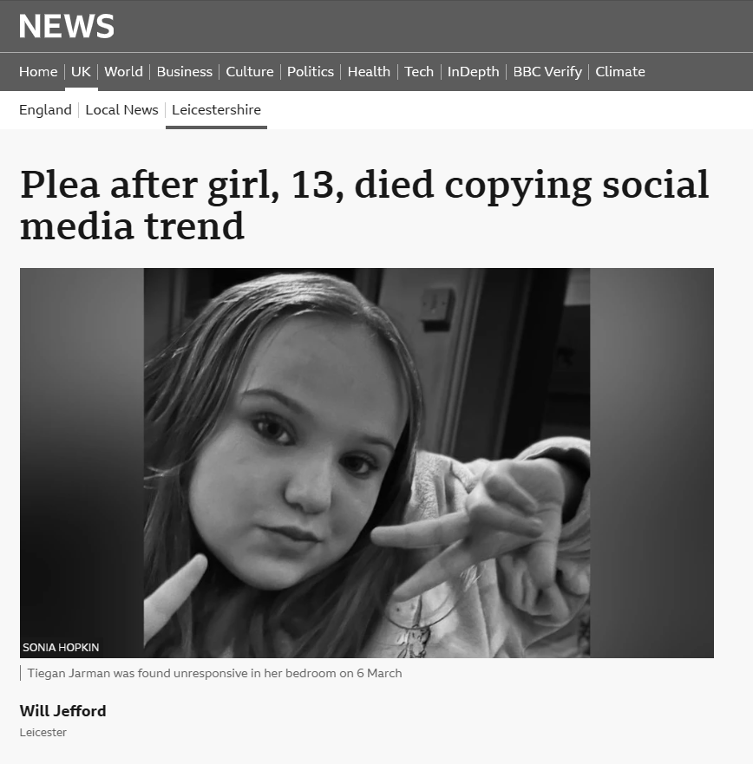
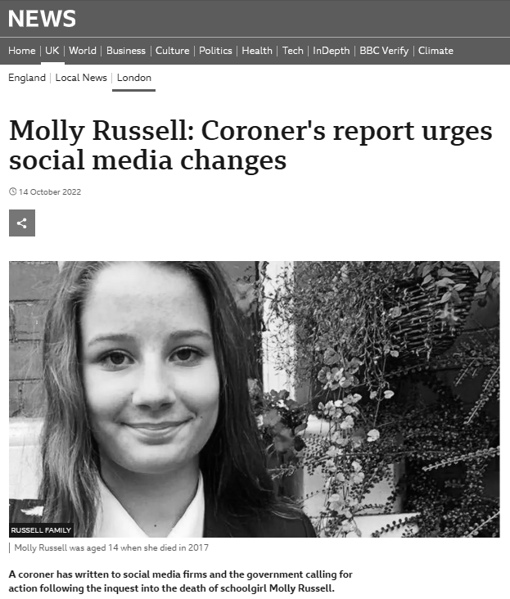
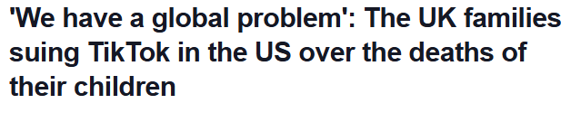
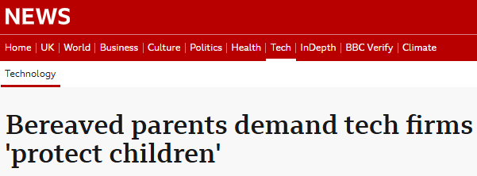

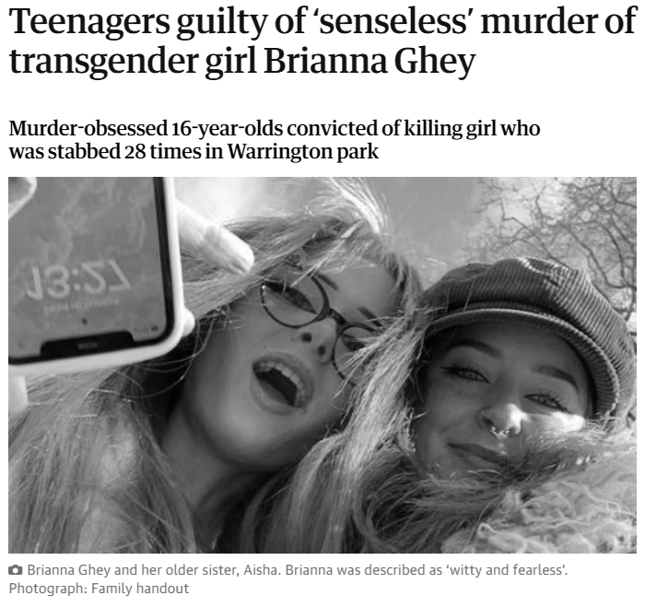
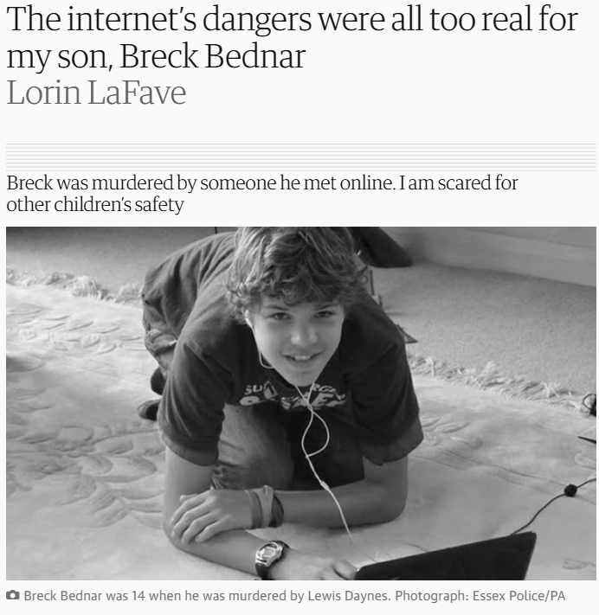
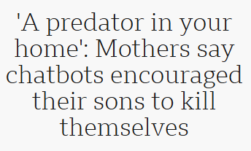


In the headlines…

Slide 5
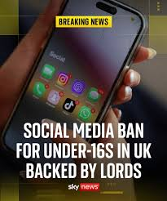
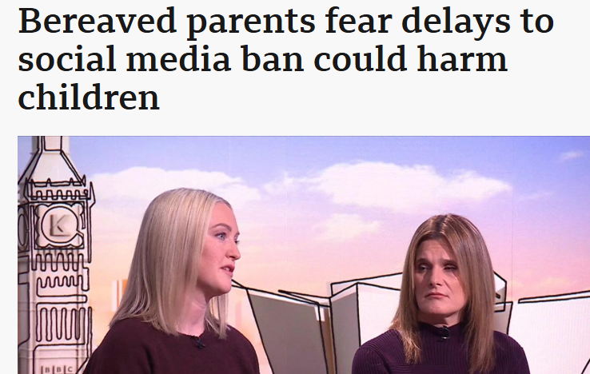

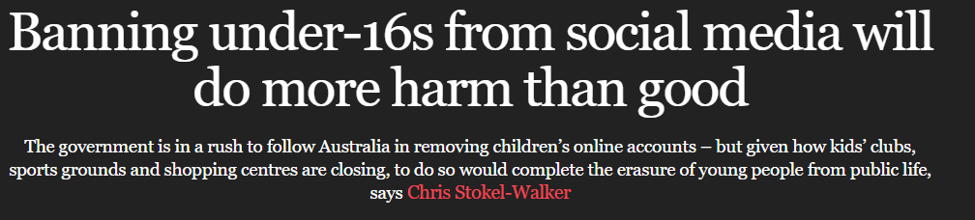
While 65% of children report that being online makes them feel "mostly happy," approximately 63% of parents believe it negatively impacts their child's health” (NSPCC, 2024)
A contested issue

Slide 6










Harm inside the home
Inter-connected
spaces and places
Harm outside the home
Online-Harm

Slide 7
Children and Young People’s Online Activity
92.6% of children aged 10–15-year-olds go online daily or almost daily.
30.1% use the internet almost all the time.
58.1% spent three or more hours online on an ordinary school day.
Children and young people spend a significant amount of time in the online space
ONS (2023)

Slide 8
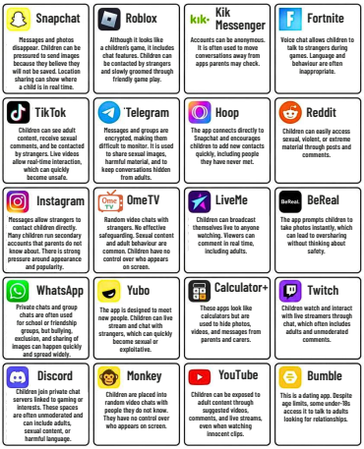
What are children and young people doing online?
Using digital platforms to maintain friendships, build new circles and communicate daily
  Social media (WhatsApp, Snapchat, Discord, Instagram).
Gaming, streaming and/or creating video content
    Fortnite, Roblox, Minecraft.
    YouTube and TikTok
    Twitch or TikTok Live
  Learning, homework, research
    YouTube, AI Tools, Online Classroom Systems, Google.
  Immersive experiences and virtual platforms
    Virtual Reality (e.g. VR gaming, VR chat), AI, Meta Horizon Worlds, Avatars, Virtual Events.
  Identity exploration and belonging
    Online support groups, following influencers or SEND-specific content.
Social Media Platforms www.socialworkerstoolbox.com

Slide 9
Summary of Benefits
Framework of Benefits
Knowledge
Connection
Enjoyment
Expression
Nearly eight in ten (78%) children say the internet helps with schoolwork, and more than half (55%) use it to learn new skills.
Almost three-quarters (72%) of 13-17s who use these platforms say they help them feel closer to friends
Seven in ten (69%) 13–17-year-olds go online to support their wellbeing, mainly to relax (45%) or lift their mood (32%).
Ofcom Davidson et al (2020)
Online Nation Report (2025)

Slide 10
Types of Risks
Four C’s Framework
Content
Contact
Conduct
Commerce
Seven in ten 11–17-year-olds had seen or heard harmful content online in the last four weeks.
Nine in ten children aged 8-17 (91%) who said that someone had been ‘nasty or hurtful’ to them said it had happened via some form of communications technology.
43% of those who spent money in social environments regretted purchases made on social media sites and apps.
Online Nation Report (2025)
Livingstone, S. and Stoilova, M. (2021)

Slide 11
“Let‘s say a young person is going through quite a bit…they can find information [online] that they can use to support themselves or get help.”
“[We] get access to education… a lot of tools for GCSEs like past papers.”
“You get to see what’s going on in the world because young people don’t really watch the news.”
Local Insights from CYP
“Another problem [is] grooming and catfishing -a lot of young people start talking to people online that are not really safe for them and then they end up doing things that they probably wouldn’t want to do.”
“People can be deceived by luxury lifestyles, get drawn into being a holder or a runner for county lines, and end up [down] the wrong path because they have seen it as “luxury.”
“Social media puts an impact on how someone is supposed to look which can affect mental health and confidence.”

Slide 12





Risk Factors
Family
& Home
Peer
& Social
Platform & Tech
Individual
Societal
Younger age
Low self-esteem or mental health difficulties
Neurodiversity or SEND needs
High screen time, especially unsupervised
Risk-taking behaviours
Previous victimisation
Low parental monitoring of online activity
Poor parent-child communication
Limited parental digital literacy
Family conflict or instability
Lack of clear rules about internet use
Peer pressure
Desire for social validation
Social isolation and/or exposure to bullying offline
Normalisation of harmful online behaviours
Anonymous platforms
Encrypted or disappearing messages
Algorithm-driven content amplification
Easy access to strangers
Poor moderation systems
Digital inequality (limited access to safety education)
Cultural stigma around reporting abuse
Inadequate legal protection or enforcement
High societal prevalence of online hate or extremist content

Slide 13
Protective Factors
Family
& Home
Peer
& Social
Platform & Tech
Individual
Societal
High self-esteem
Emotional regulation skills
Good social skills
Digital literacy and skills
Open communication about online experiences
Use of safety features and control
Non-judgmental responses when children disclose problems
Involvement in offline activities
Positive on/offline friendships
Availability of trusted adults
Online safety education programs
Availability of off-line activities
Access to support
Privacy controls
Reporting/blocking tools
Age-appropriate design
Moderation and AI detection systems
Safety by design
Positive social norms
Legislative protection
Strong regulatory systems and activity
Access to education

Slide 14
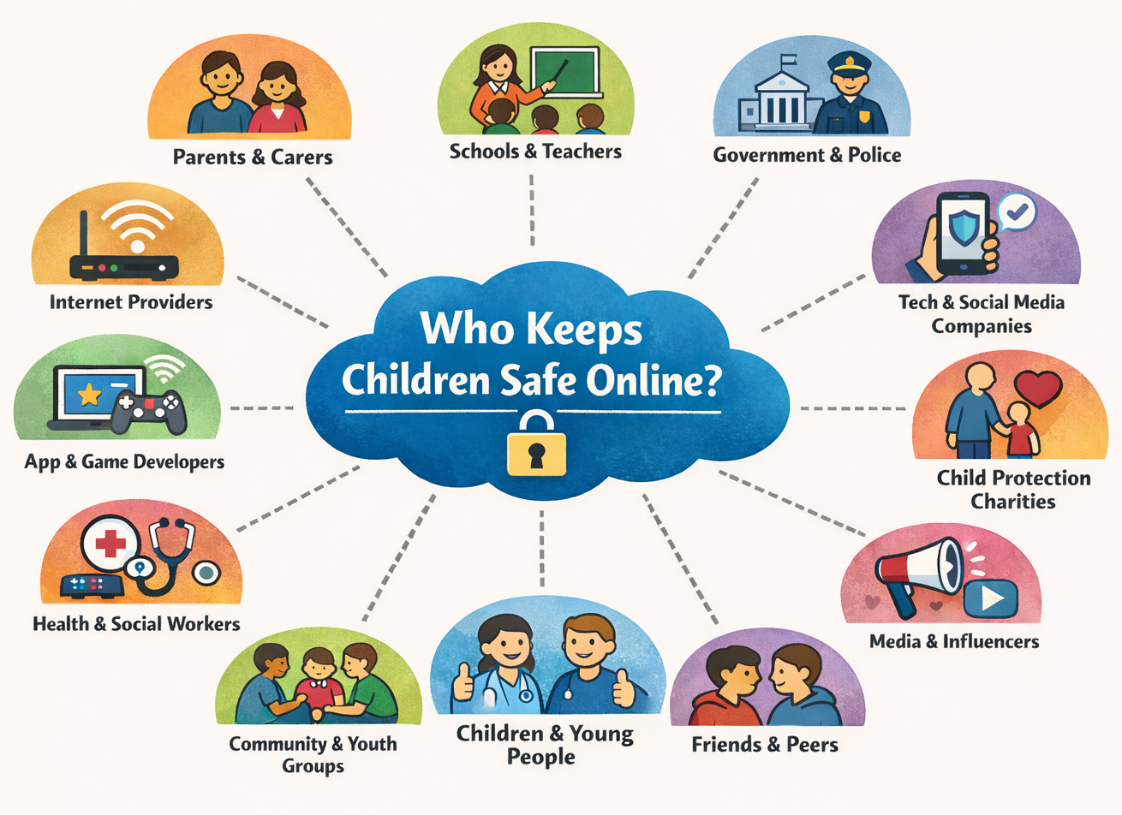
A Whole System Approach
Everyone has a role to play!

Slide 15
Online Safety Act (2023)
Illegal content & activity (breaches criminal law) | Legal but harmful content (high risk to children and young people)
Child sexual abuse Controlling or coercive behaviour Extreme sexual violence Extreme pornography Fraud Racially or religiously aggravated public order offences Inciting violence Illegal immigration and people smuggling Promoting or facilitating suicide Intimate image abuse Selling illegal drugs or weapons Sexual exploitation Terrorism | Primary Priority Content Pornography Content that encourages, promotes, or provides instructions for either: Self-harm, Eating disorders and/or Suicide Priority Content Bullying Abusive or hateful content Content which depicts or encourages serious violence or injury Content which encourages dangerous stunts and challenges; and Content which encourages the ingestion, inhalation or exposure to harmful substances.
DUTY on provider is to remove promptly (also required to take preventative action) | DUTY on provider is to prevent access and/or shield
The Act categorises content which is illegal and content that is currently legal but potentially harmful

Slide 16
The criminal offences introduced by the Act came into effect on 31 January 2024.
Encouraging or assisting serious self-harm
Cyberflashing*
Sending false information intended to cause non-trivial harm
Threatening communications
Intimate image abuse
Epilepsy trolling**
New Criminal Offences
*Sending someone photo(s) of genitals without their permission
** Deliberately sending flashing images to someone knowing or thinking they have epilepsy with the intention of causing a seizure

Slide 17
A Whole System Approach
Everyone has a role to play!

Slide 18

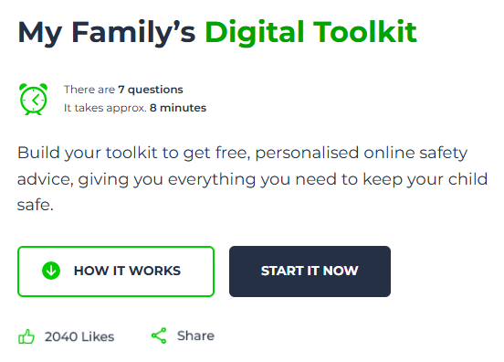
Four tips to keep children and young people safe
Activate parental controls
  Use the controls and tools available from broadband providers, online platforms and apps to install safe search settings, block inappropriate content and prevent contact from strangers.
Balance screen time
    Agree a good balance for your child’s screentime by thinking about both education and leisure. Explore whether your child’s screentime is more passive or active and consider setting a daily limit.
  Check age limits
    Every app, platform and game has minimum age requirements. Ensure you are aware of these, and your child is following them.
  Chat regularly about the online space
    Talk regularly with your child about online safety and what they might come across. Some topics might seem daunting, but your child will benefit by knowing how you’ll work together to manage risks.

Slide 19




Ismail Sarwar
Young Person
Sarah Sadler
Area Director of Schools, Learn Academy Trust
Meet the panel
Dr Nisha Karia
Clinical Psychologist, CAMHS, LPT (NHS) and MaxiMinds (Private)
Hema Badger-Mistry
Chief Executive at Pedestrian

Slide 20
Audience Q&As

Slide 21
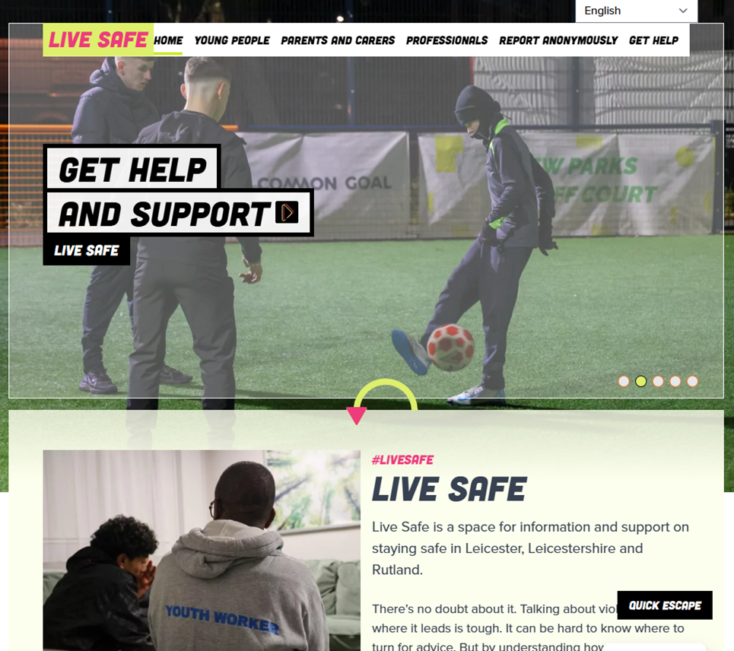







Information and Advice

Slide 22
Thank You!

